Slide 1
North Atlanta high school Budget Feedback Meeting
To be presented to GO Team BEFORE the school staffing conference

Slide 2
North Atlanta High School
Date: February 16, 2023
Time: 4:30 PM
Location: NAHS Media Center
Call to order
Roll Call; Establish Quorum
Action Items
  Approval of Agenda: 2/16/2023
  Approval of Previous Minutes: January 19, 2023
  Strategic Plan Review and Ranking Review
Discussion Items
  Review Budget Development Process
    Review and update meeting calendar (if necessary) to meet District’s timeline: New Meeting Schedule for Thursday, March 9, 2023 @ 4:30 PM; Location will be NAHS Media Center
  Budget Allocation Presentation
Information Items
  Principal’s Report
Announcements
Public Comment (if applicable)
Adjournment

Slide 3




NORMS
This is a meeting of the GO Team. Only members of the team may participate in the discussion. Any members of the public present are here to quietly observe.
We will follow the agenda as noticed to the public and stay on task.
We invite and welcome contributions of every member and listen to each other.
We will respect all ideas and assume good intentions.

Slide 4

GO Team Budget Development Process
YOUR SCHOOL STRATEGIC PLAN…
is your roadmap and your role.
It is your direction, your priorities, your vision, your present, your future.
Step 1: Data Review
Step 2: Strategic Plan Review
Step 3: Budget Parameters
(Strategic Priorities)
Step 4: Budget Choices
Notes:
Today I will provide an overview of the budget allocations for FY23. We will begin the work of funding the strategic priorities we agreed upon during our strategic review meeting. (IF YOU HAVE NOT DECIDED ON YOUR PRIORITIES, YOU WILL SAY – WE WILL DECIDE ON OUR PRIORITIES AND THEN DISCUSS ALLOCATING FUNDS TO ADDRESS THOSE PRIORITIES).

Slide 5
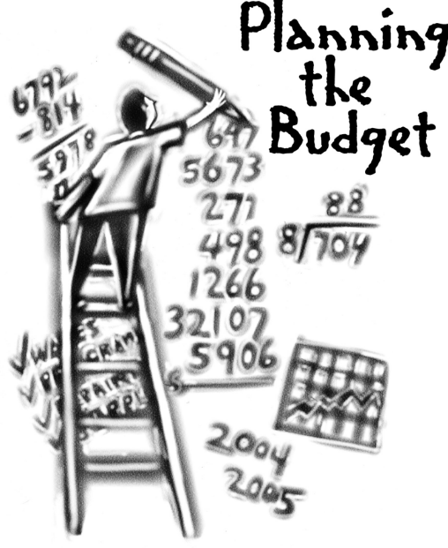
Overview of FY ‘24 GO Team Budget Process
Step 1 Review and Update Strategic Plan and Rank Strategic Priorities
By end of Fall Semester
Step 6 Principals: HR Staffing Conferences Begin
Late February – Early March
Step 3 GO Team Initial Budget Session: Allocation
January 24 – early February
Step 7 GO Team Final Budget Approval Meeting
Budgets Approved by March 17
Step 5
GO Team Feedback Session: Draft Budget Presented & Discussed February – multiple meetings, if necessary
Step 4 Principals: Associate Supt. Discussions and Review
February (supports needed, specific challenges, coaching)
Step 2 Principals: Workshop FY 24 Budget
January 24
GO Teams are encouraged to have ongoing conversations

Slide 6
Budget Feedback Meetings
What
The GO Team feedback session(s) should be scheduled for the principal to provide an overview of the school’s draft budget for the GO Team members and the general public.
Why
This meeting provides an opportunity for GO Teams to discuss how the school’s budget has been allocated to support the programmatic needs and key strategic priorities.
When
Meetings must be held in February before staffing conferences. May be combined with the allocation meeting (as needed), if the GO Team has completed strategic plan updates and ranked strategic priorities.
Notes:
Looking for general consensus prior to Staffing Conferences

Slide 7

FY24 Budget Parameters
FY24 School Priorities | Rationale
Ensure that instructional resources and supplies are available to every teacher and staff. | Teachers need to have the resources they need to be effective and for students to thrive. Without adequate resources nothing in the strategic plan can be achieved.
Improve student mastery in areas of Math, Science, Social Studies, and ELA by implementing best practices that will ensure rigor. | North Atlanta High School students will be College and Career Ready when they graduate.
Implement all DLI and IB programmes (MYP, DP, & CP) with fidelity through utilization of the IB Programme Development Plan (DLP), including expanding program diversity | IB and DLI are programs that have proven to successfully prepare students for college. Diversifying the program provides an opportunity for all students to benefit from the programs.
Notes:
Review the priorities that the GO Team has developed and the rationale for these priorities. Feel free to copy this slide if you have more than 3 priorities to account for.

Slide 8
FY24 Budget Parameters
FY24 School Priorities | Rationale
Provide greater support for at-risk students. | They will be able to graduate in 4 years.
Improve student graduation rate. | Graduation rate declined 4 percentage points to 89.9%.
Develop a positive, informed, and engaged school community. | Students are more engaged when their parents/guardians are engaged.
Support efforts to build community and school spirit. | Building community helps to connect the students to the school.
Notes:
Review the priorities that the GO Team has developed and the rationale for these priorities. Feel free to copy this slide if you have more than 3 priorities to account for.

Slide 9
Mission Through a nurturing culture that embraces equity and diversity, promotes academic rigor, and fosters integrity, North Atlanta High School will develop inquiring, responsible, and caring young adults who will graduate ready for college, career and life.
SMART Goals
North Atlanta High School
Vision North Atlanta High School, through holistic learning and collaboration among engaged students, educators, families, and community, will foster an environment of critical thinkers who are globally and culturally aware.
By the end of the 2021 - 2022 school year, and each subsequent year, the
percentage of students earning a score of proficient and above on the Algebra I EOC and American Lit EOC will increase 3% or higher.
The percentage of ELL, Hispanic and Students with Disabilities who graduate in four years will increase 3% or higher for each subgroup from June 2021 to July 2022 and each subsequent year of this plan.
The percentage of high school students who score 4 or higher on two or more IB exams will increase by 5% or higher from 79% in June 2019 to 84% or higher in June 2024 and maintain growth each year.
Decrease the disproportionality by 10% in discipline incidents between our subgroups through the use of restorative practices, social emotional learning and conflict resolution by the end of each school year.
APS Strategic Priorities & Initiatives
School Strategic Priorities
School Strategies
1. Improve student mastery in the content areas of Math, Science, Social Studies, and ELA by implementing best practices that will ensure rigor
1A. Continue emphasis on Professional Learning Communities (PLCs) with focus on all subject groups where teachers will work together to plan units and lessons, create assessments, implement common instructional frameworks, and utilize data.
2A. Implement and strengthen all IB programmes by utilizing IB Programme Development Plans.
2B. Increase minority, ELL, SWD participation in the DP/CP program through early identification of rising 9th grade students
3A. Utilize all student performance data to inform enrichment and remediation opportunities.
3B. Utilize APSGraphs to analyze cohort data. Counselor review credits and schedule students with courses needed and classes for pathway completion. Counselors perform quarterly cohort updates
Fostering Academic Excellence for AllData Curriculum & Instruction Signature Program
Implement all IB programmes (MYP, DP, & CP) with fidelity through utilization of the IB Programme Development Plan (PDP), including expanding program diversity
Improve student graduation rate
Building a Culture of Student Support
Whole Child & Intervention Personalized Learning
4. Provide greater support for at-risk students
4A. Care Team and CIS will work with students who have consistent attendance and discipline issues to assist with identifying resources, pathways, and organizations to increase students’ social, emotional and academic achievement.
4B. Implement Social Emotional Learning (SEL) curriculum.
4C. Parent Miniversity, Grade Level Meetings and Parent Townhalls - Parent sessions designed to inform and engage parents in their students’ school life.
4D. Utilizing and increasing student support structures to address universal screener data.
Equipping & Empowering Leaders & Staff
Strategic Staff Support Equitable Resource Allocation
5. Ensure that instructional resources and supplies are available to every teacher and staff.
5A. Provide training, support, and professional development for teachers in the following areas: IB programmes; APS 5; and research based instructional strategies that promote inquiry and differentiation. 5B. Allocate time and provide resources for professional development during district Professional Learning days, release days, and PLC’s.
Creating a System of School Support
Collective Action, Engagement & Empowerment
6A. Strengthen the engagement of the school community by celebrating diversity and building intercultural understanding
7A. Strengthen the PTSA Family Engagement & Communications Committees in an effort to recruit more families and increase support.
7B. Build community awareness for IB by broadening the avenues of communication with parents; IB Parent Coalition reflects the diversity of the school.
7C. Provide leadership and support for messaging and capital campaign
6. Develop a positive, informed, and engaged school community.
7. Support efforts to build community and school spirit
2

Slide 10
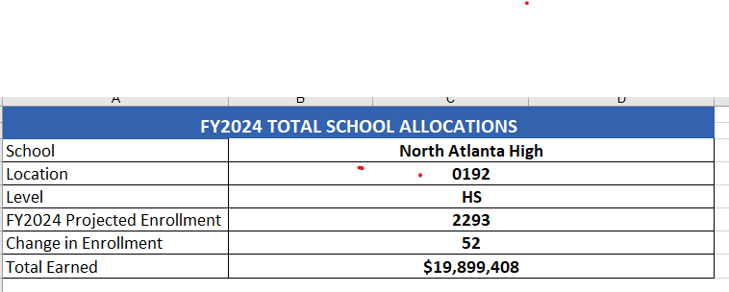

Slide 11
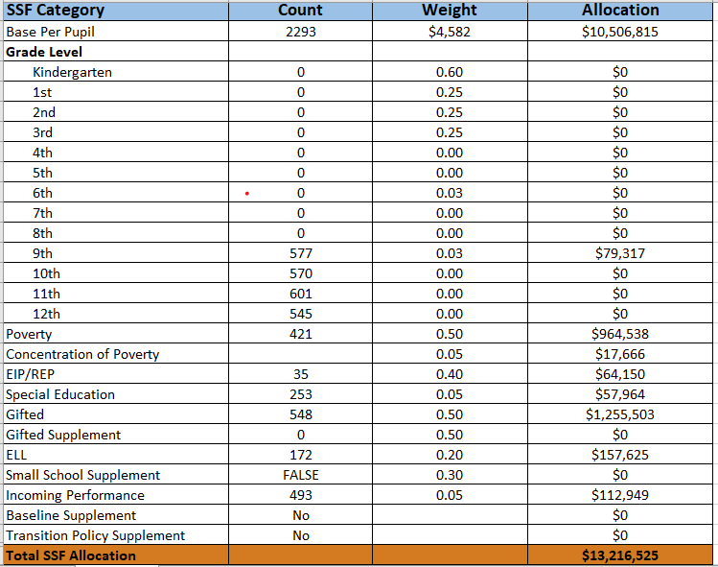

Slide 12
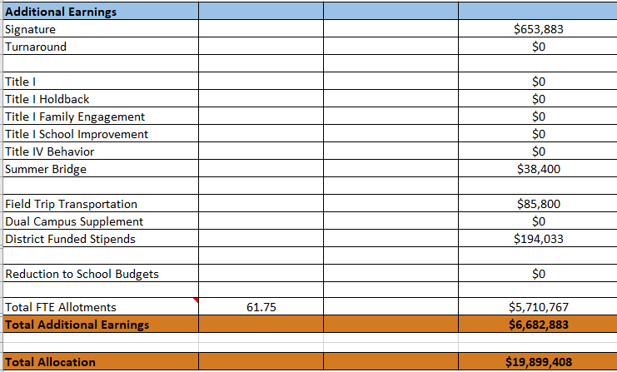

Slide 13
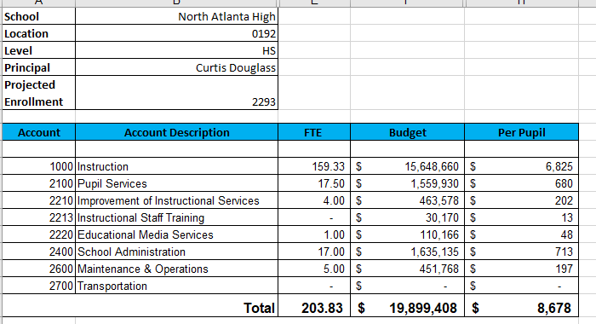

Slide 14
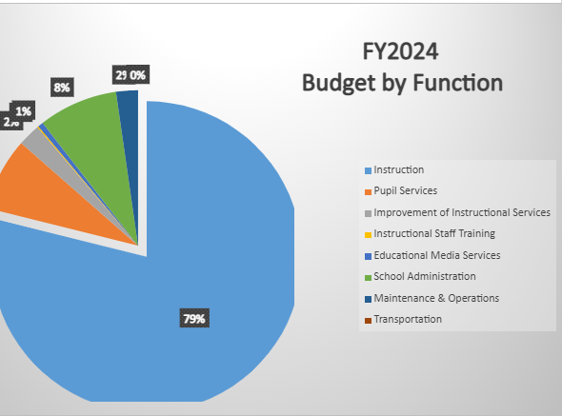
Budget by Function (Required)
*Based on Current Allocation of School Budget
Notes:
Explain the pie chart and allocations

Slide 15
Plan for FY24 CARES Allocation $402, 623
Priorities | APS FIVE Focus Area | Strategies | Requests | Amount
Provide additional support for at –risk Students | Whole Child Intervention |  | Pay for services from Communities in Schools Restorative Practices Coach | $176,861
Resources for Students and Teachers | Curriculum and Instruction Personalized Learning |  | Replace Active Boards in classrooms, purchase more Chromebooks, purchase web-based subscriptions, and other instructional supplies | $170,000
Notes:
For the next few slides, I will show you how I have allocated the budget to support our strategic priorities.
Based on our strategic priorities and funds we received, here is a break-out of the priorities, which focus area it addresses, the strategies that will be implemented, the purchase request, which funding source was used and the amount.

Slide 16
Discussion of reserve and Holdback funds

Slide 17
Plan for FY24 Leveling Reserve
$_264,000
Priorities | APS FIVE Focus Area | Strategies | Requests | Amount
Increase level of rigor and relevance | Curriculum and Instruction Signature Programming | Lower class size | Purchase an additional Teacher | $95,311
Help at-risk students and improves graduation rate | Whole Child Intervention | Lowers case load | Additional counselor | $111,421
Notes:
For the next few slides, I will show you how I have allocated the budget to support our strategic priorities.
Based on our strategic priorities and funds we received, here is a break-out of the priorities, which focus area it addresses, the strategies that will be implemented, the purchase request, which funding source was used and the amount.

Slide 18
Questions for the GO Team to Consider and Discuss
Are our school’s priorities (from your strategic plan) reflected in this budget?
Are new positions and/or resources included in the budget to address our major priorities?
Do we know (as a team) the plan to support implementation of these priorities beyond the budget (ex. What strategies will be implemented)?
What tradeoffs are being made in order to support these priorities?
How are district and cluster priorities reflected in our budget?
Cluster priorities- what staff, materials, etc. are dedicated to supporting our cluster’s priorities?
Signature programs- what staff, materials, etc. are dedicated to supporting our signature program?
Are there positions our school will share with another school, i.e. nurse, counselor?
Notes:
CHAIR - Our final task for today! Here are questions that we need to consider to ensure we have a good working draft budget. Let’s walk through them together.

Slide 19
Where We’re Going?
Our next meeting is the Budget Approval Meeting
What:
During this meeting we will review the budget, which should be updated based on feedback from the staffing conference, Associate Superintendents, and key leaders. After review, GO Teams will need to take action (i.e., vote) on the FY24 Budget.
Why:
Principals will present the final budget recommendations for GO Team approval.
When:
All approval meetings must be held after staffing conferences. Budgets must be approved by March 17th.

Slide 20
What’s Next?
February
  HR Staffing Conferences (Late February)
March
  Final GO Team Approval Meeting (AFTER your school’s Staffing Conference and BEFORE Friday, March 17th)
Notes:
In February, we will meet again to discuss how the school’s budget has been allocated to support the programmatic needs and FY23 key strategic priorities.
If think we need to continue our budget conversations, we will schedule additional meetings. My goal is to make sure your voices are reflected in our school’s budget.
I will also be meeting with my Associate Superintendent, program managers and other key leaders to go over our budget and to make sure the school is meeting the standards of service and appropriately staffing.
During the week of Feb. 24th -March 2nd , HR Staffing Conferences will be held. At this meeting, I will present my plan for staff utilization, resource distribution and plan for staffing implications.
We will need to approve the budget at the ________ meeting.

